Slide 5
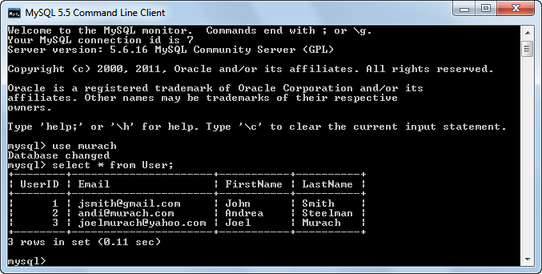

Slide 6
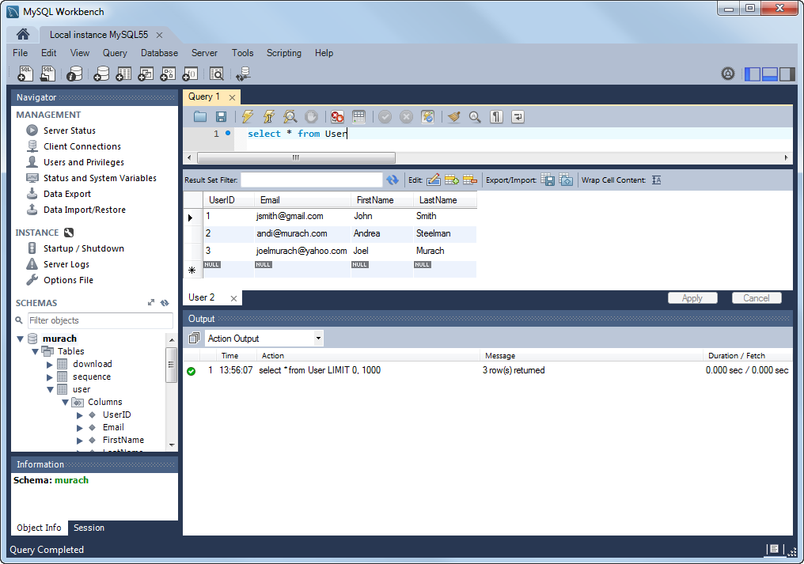

Slide 7
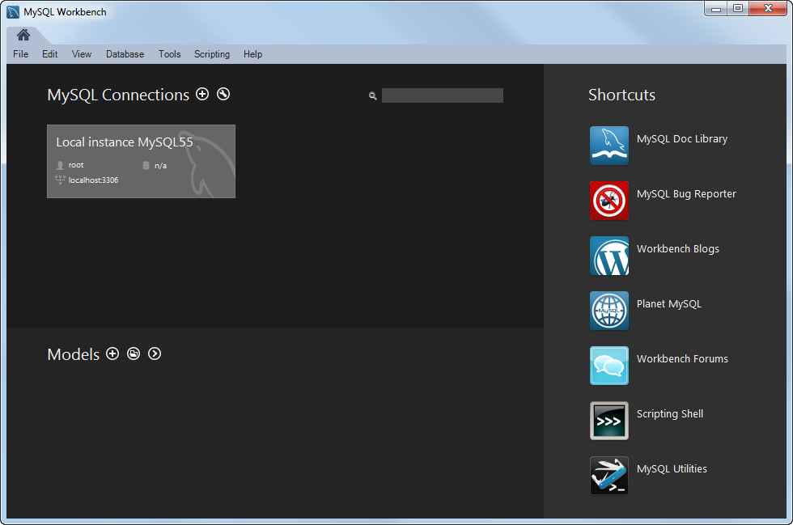

Slide 8
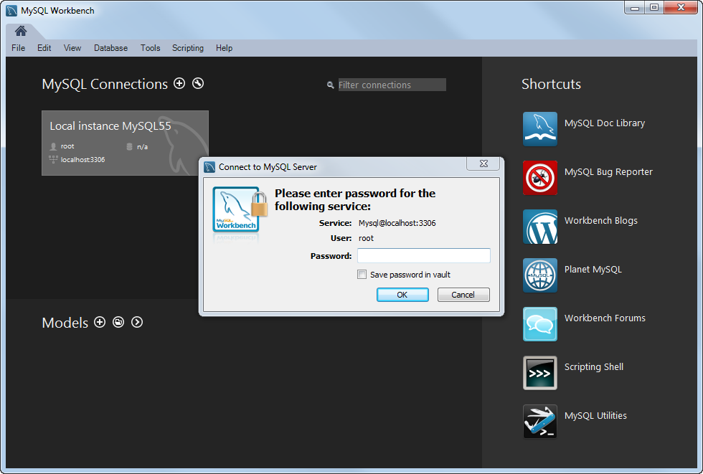

Slide 9
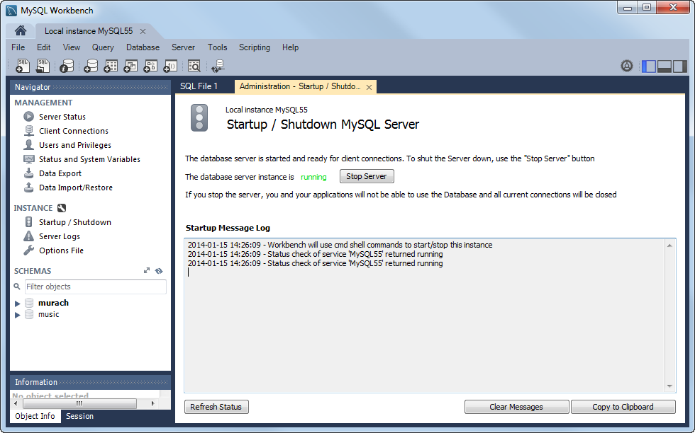

Slide 10
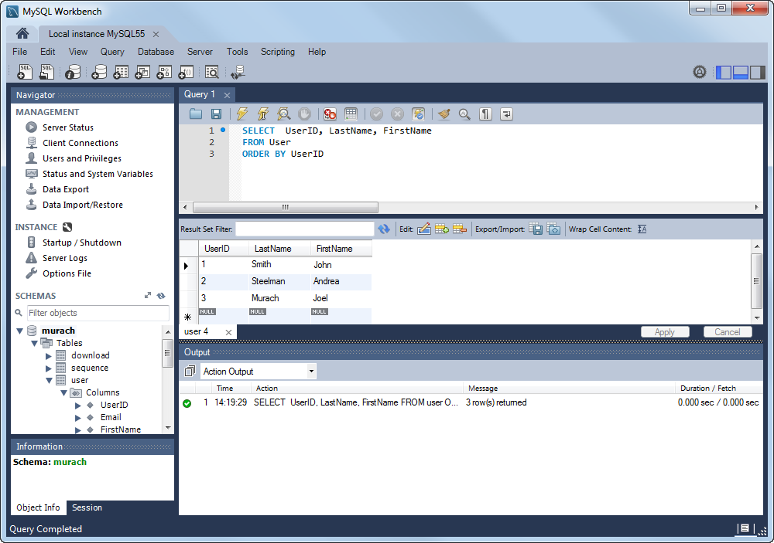
Create New SQL Tab button
Execute Current Statement button
SQL tab
Results tab

Slide 12
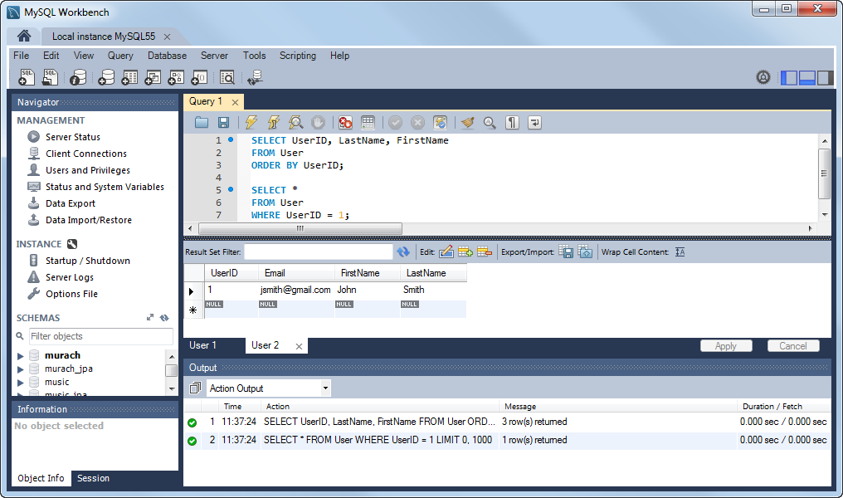
Execute SQL Script button

Slide 14
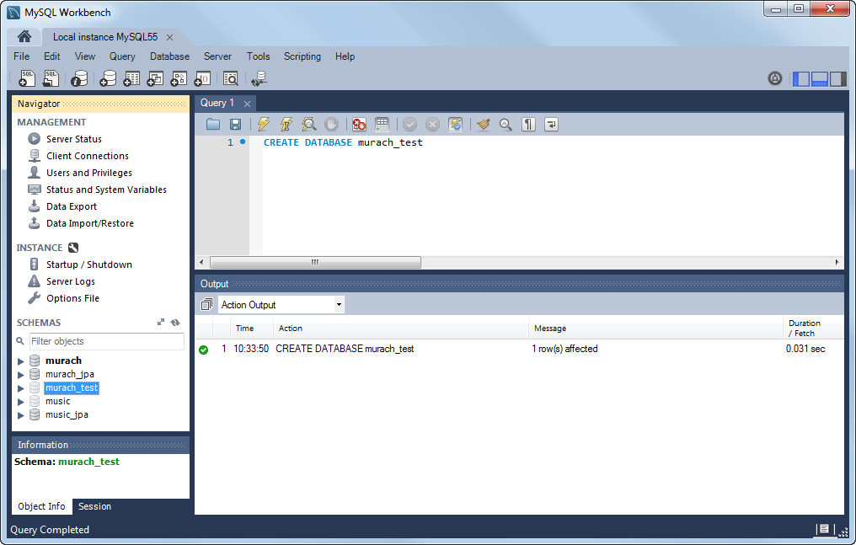

Slide 20
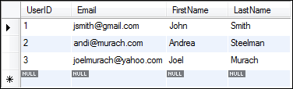

Slide 21


Slide 23
Implicit inner join:
select *
from table1 a, table2 b
where a.id = b.id
Note the use of the alias for the table names

Slide 24
